Slide 1

BY-
NAVEEN REDDY
NAGA MUNILATHA
NANDA VARSHITHA REDDY
LEENA VARMA

Slide 2
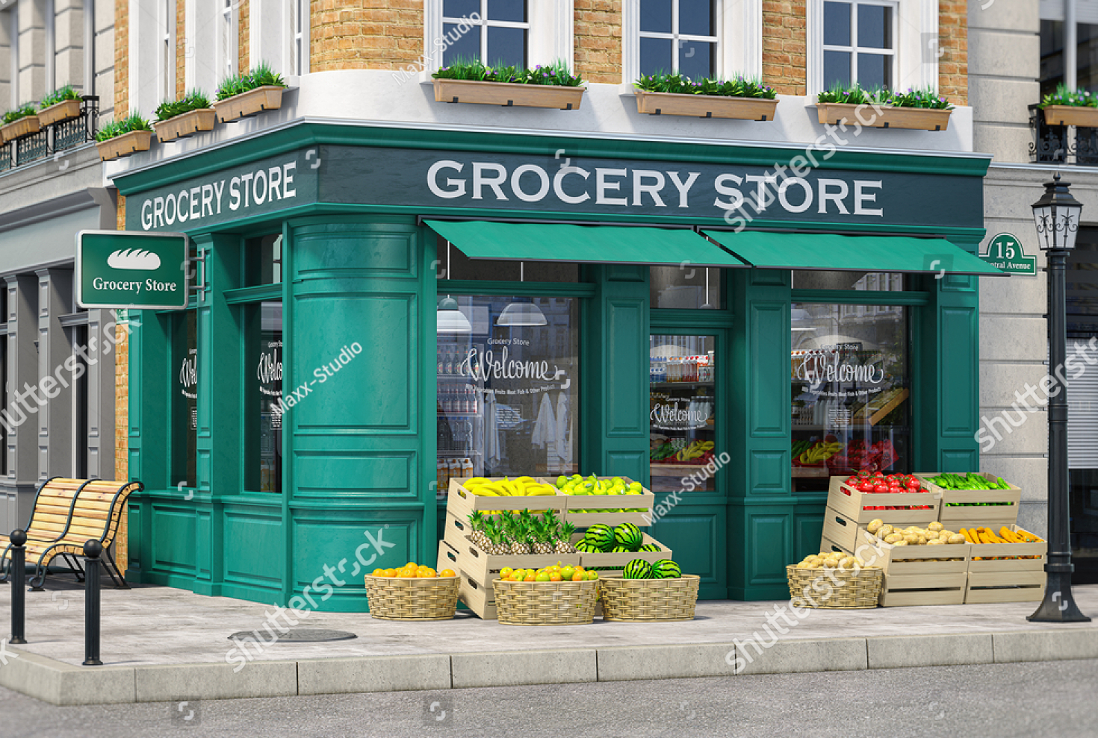

Grocery Store Management
Introduction
This project simulates a mini grocery store database. We will use SQL to manage data derive business insights.

Slide 3
Problem Statement
Design and implement a relational database system for a grocery store to manage suppliers, products, customers, employees, and orders. Perform comprehensive data analysis using SQL to extract business insights related to customer behavior, product performance, sales trends, supplier contributions, and employee efficiency.

Slide 4

Domain Knowledge: Retail & Grocery
Key Aspects
Inventory management
Supplier relations
Customer orders
Employee activity
supplier
Benefits of Data Management
Track sales and revenue
Monitor product availability
Inventory management system
Make good decisions

Slide 5
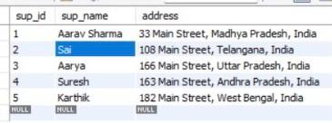
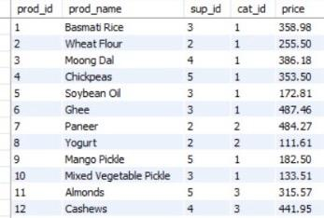
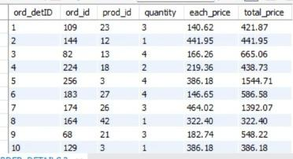
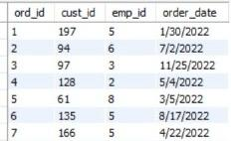
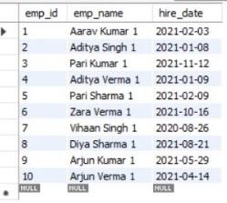
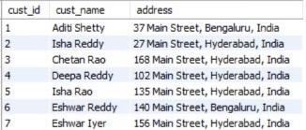
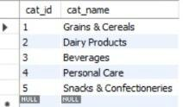
Tables
Supplier
Orders
Order_Details
product
Customers
Categories
Employees

Slide 6
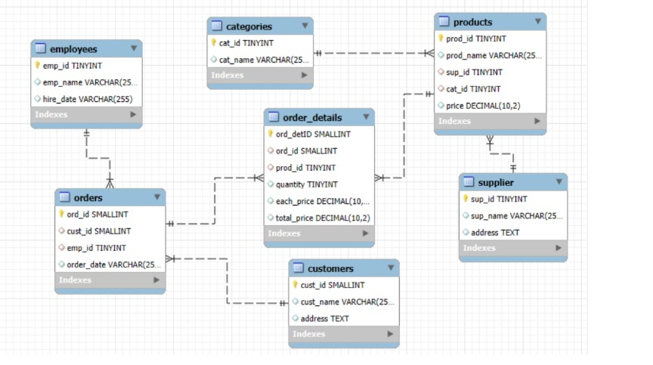
ER Diagram
An Entity Relationship (ER) diagram is a visual representation of entities and
their relationships in a database
It helps in database design by mapping out relationships constraints clearly

Slide 7
Database Schema interrelated Tables
Core Entities
Supplier Categories Employees,
Customers.
Product Information
Products table links suppliers
and categories.
Order Details
Orders and Order_Details track
customer purchases

Slide 8


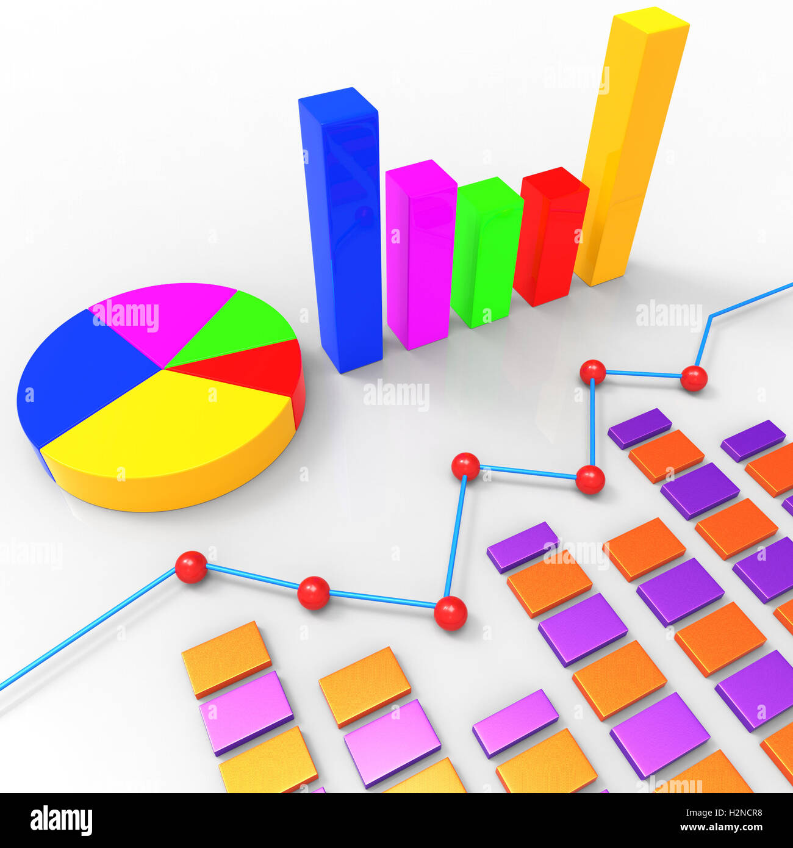
Project Objectives
Design & Implement
Create a relational database for the
Grocery store
Retrieve & Manipulate
Use SQL queries for data extraction
And transformation
Analyze Data
use SQL queries for data extraction
and transformation

Slide 9
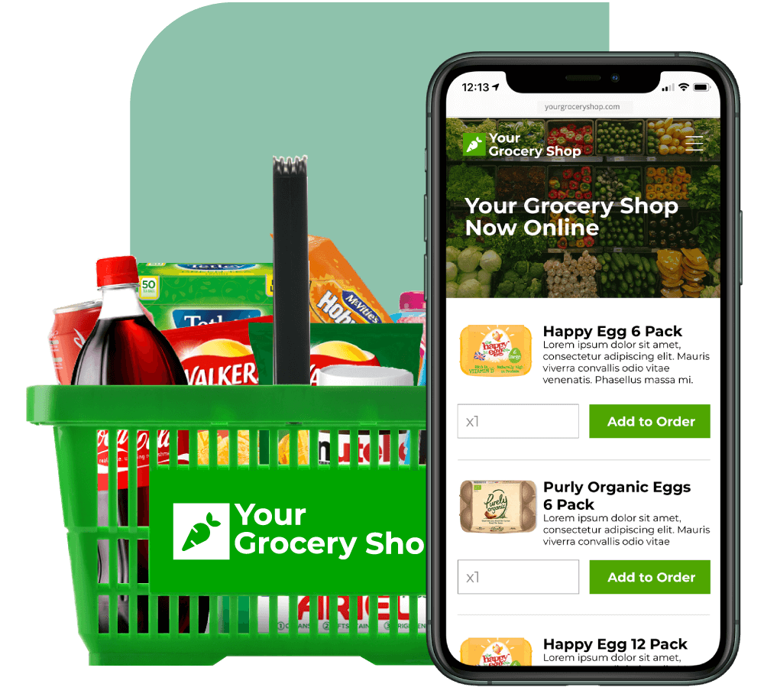
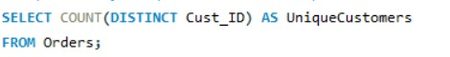
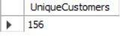
Customer Insights
How many unique customers have
placed orders ?

Slide 10
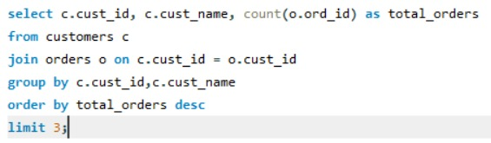
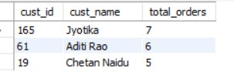
2. Which customers have placed the highest number of orders

Slide 11
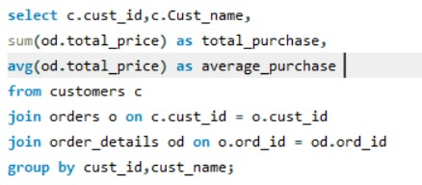
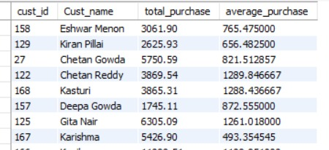
3.What is the total average purchase value per customer

Slide 12
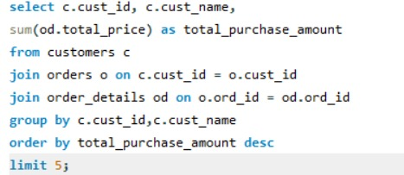
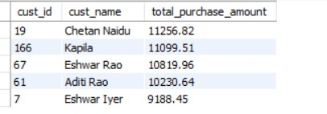
4.Who are the top 5 customers by total purchase amount

Slide 13

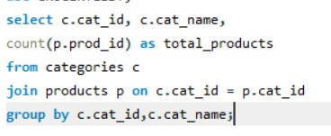
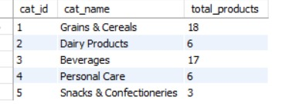
Product Performance
5.how many unique products exists in each category

Slide 14

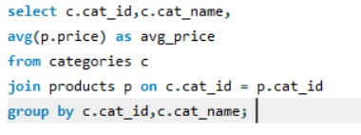
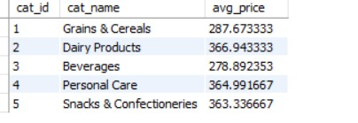
6.What is the average price of products by category

Slide 15
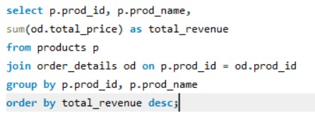
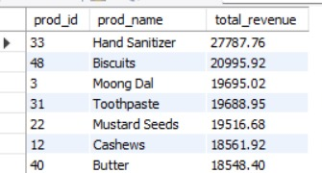
7.What is the total revenue generated by each product

Slide 16

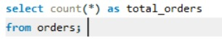
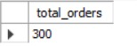
Sales and Order Trends
8.How many orders have been placed in total

Slide 17

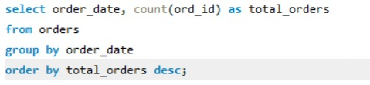
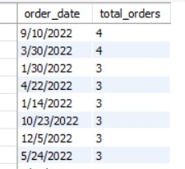
9.On which dates were the most orders placed

Slide 18

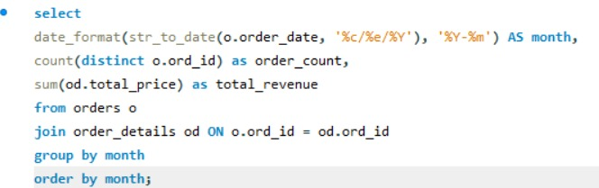
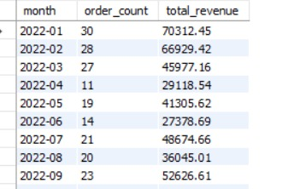
10.What are the monthly trends in order volume and revenue

Slide 19

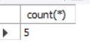
Supplier Contribution
11.How many suppliers are there in
the database

Slide 20
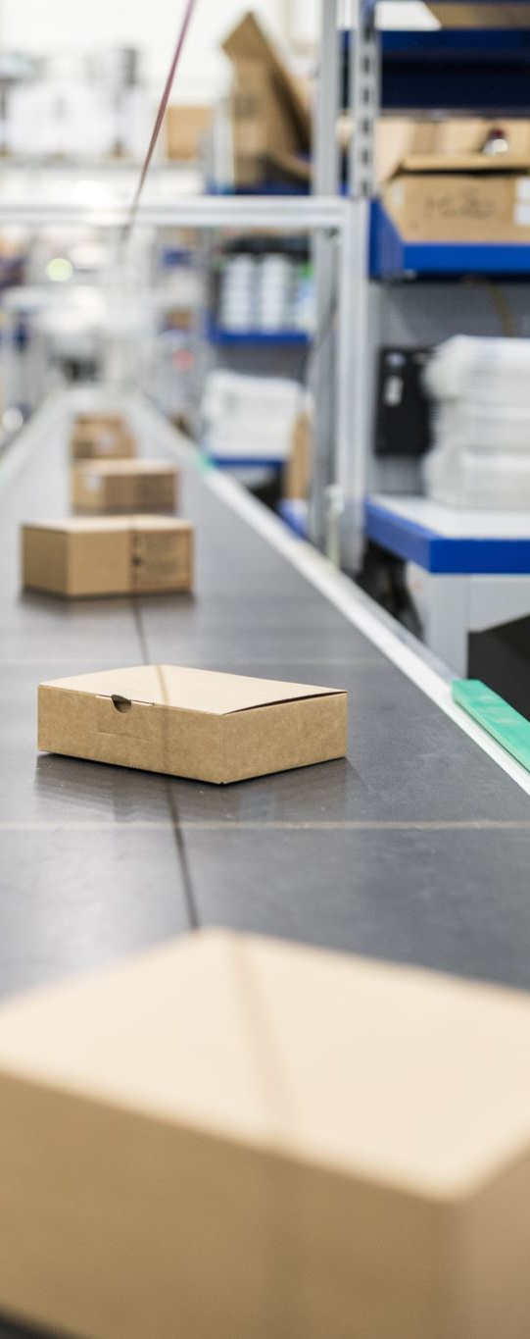
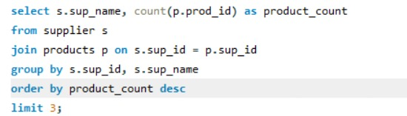
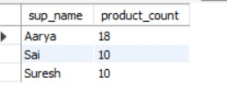
12.Which supplier provides the most products

Slide 21
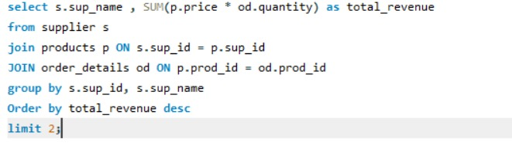
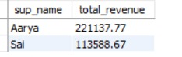
13.Which suppliers contribute the most to total product sales (by revenue)

Slide 22

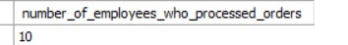
Employee performance
14.How many employees have processed orders

Slide 23
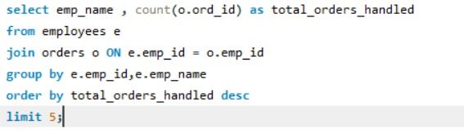
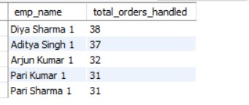
15.Which employees have handled the most orders

Slide 24

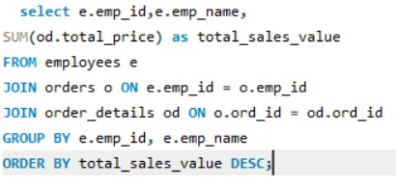
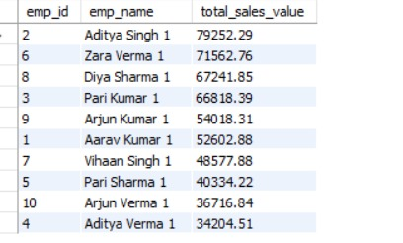
16.What is the total sales value processed by each employee

Slide 25
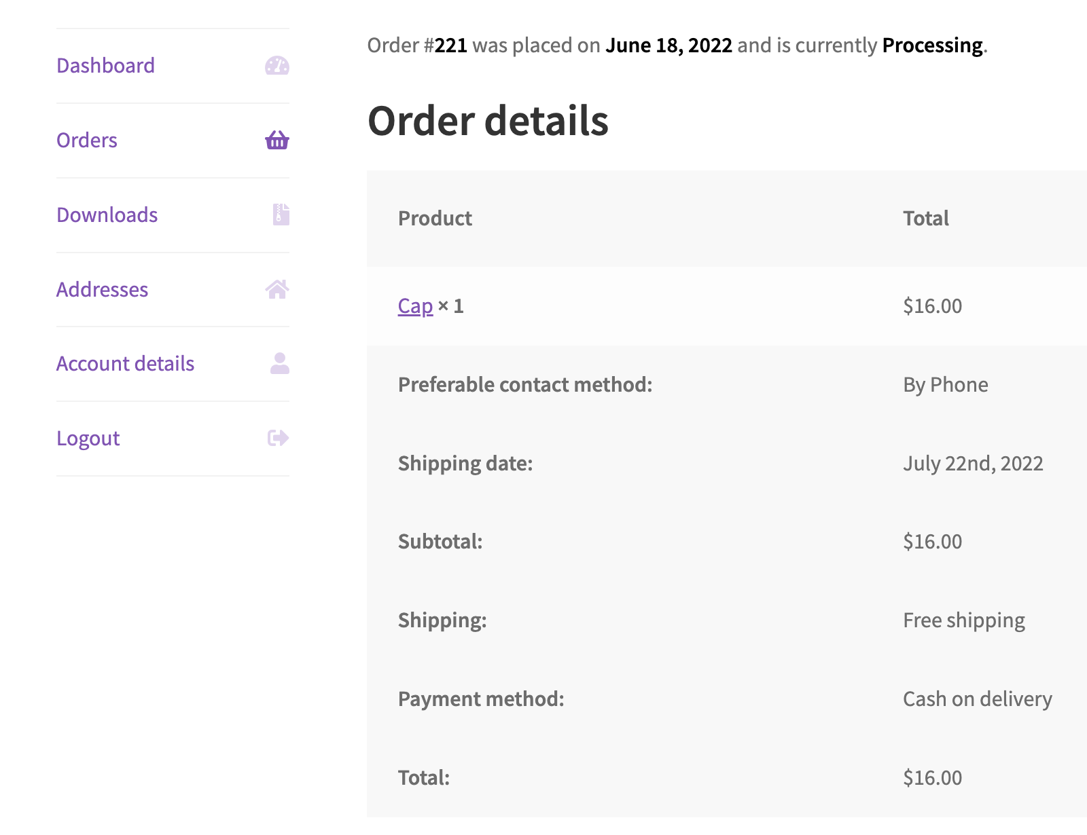
Order Details Deep Dive
17.What is the relationship between quantity ordered and total price

Slide 26
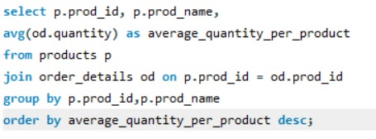
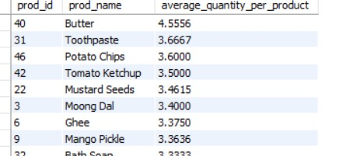
18.What is the average quantity ordered per product

Slide 27


Slide 28


